Slide 1

Optimizing the UofA Schedule Planner
Streamlining Course Planning
Sterling Hayden
Jacob Brecheisen
College of Engineering
University of Arkansas
April 2, 2023

Slide 2
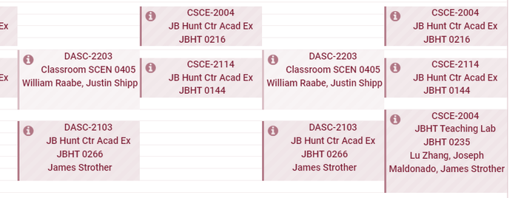

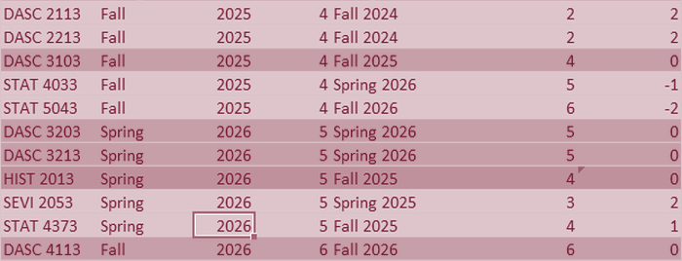
Developing an Optimization Model to Improve the University of Arkansas Schedule Planner​
Scope of Problem
Model Formulation
Results

Slide 3
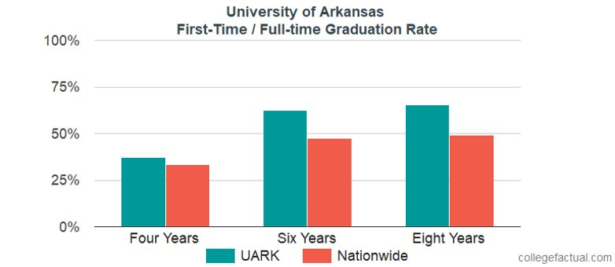
Traditional four-year plans are losing relevance as students struggle to meet requirements

Slide 4
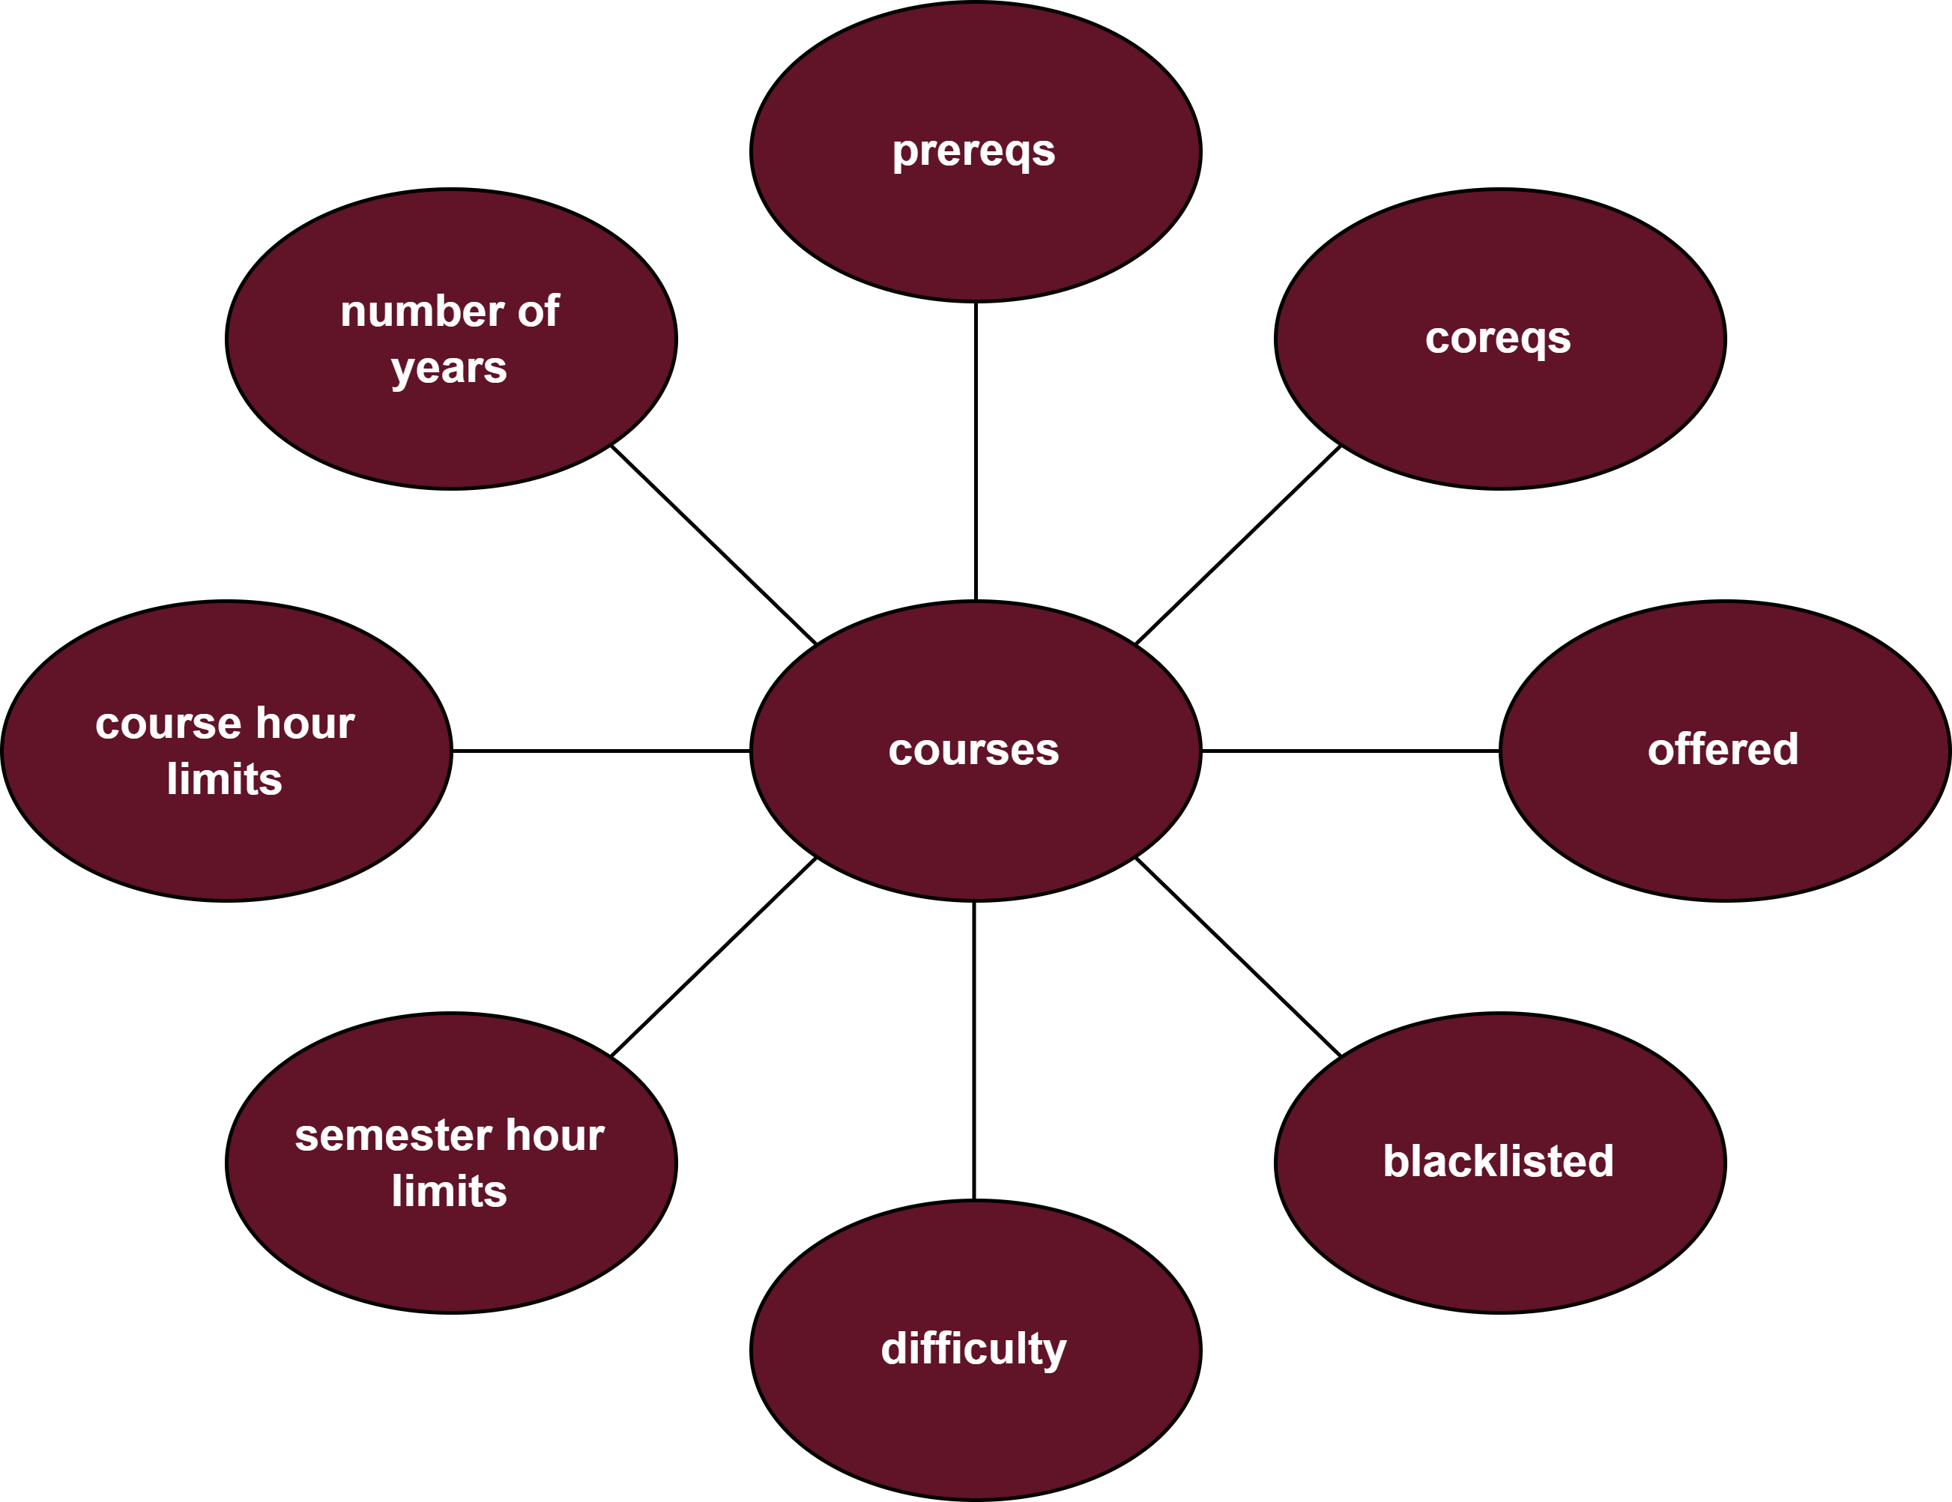
The Building Blocks of Our Optimization Model: Understanding Parameters

Slide 5
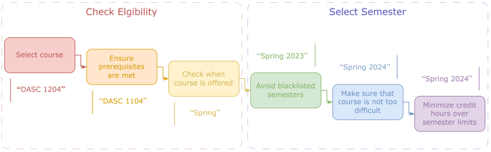
The Anatomy of Our Optimization Model: Key Formulation Components

Slide 6
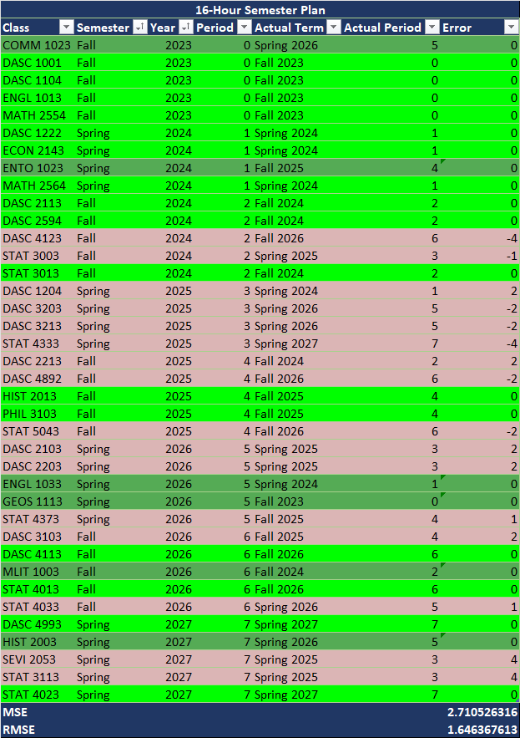
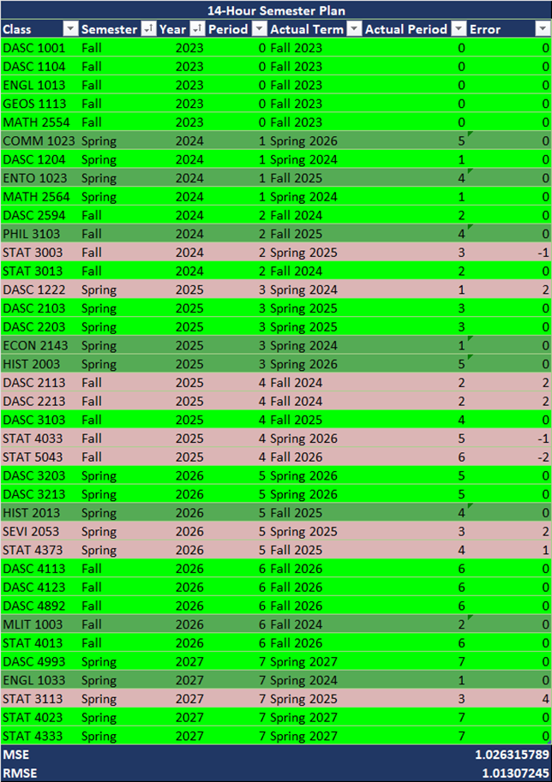
Unlocking the Power of Our Optimization Model: Results & Insights

Slide 7

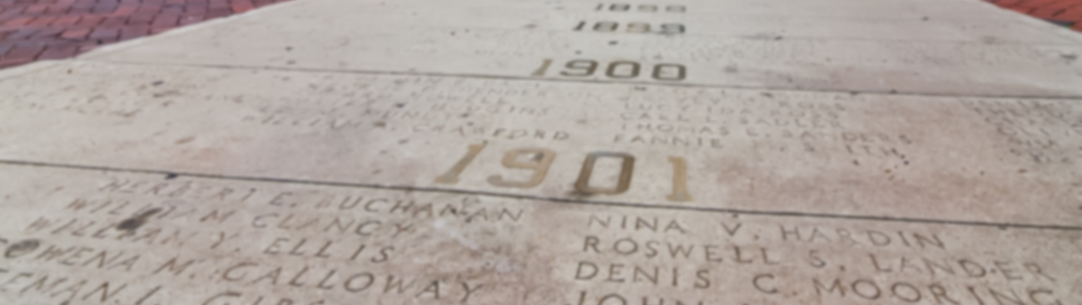
Optimizing the UA Schedule Planner: Key Insights and Recommendations
13-15 hour semesters produces optimal schedules
Large semester hour limits produce unrealistic schedules
Smaller semester limits produces schedules that are out of order and include summers
Early semesters are fairly constricted to a certain order
Questions?

